Slide 1
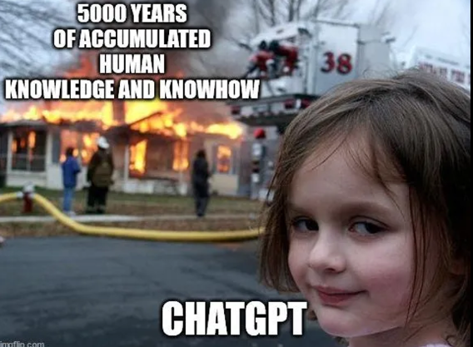
The Limits of AI
Not a substitute for independently thinking or interpretation
  Remember—in this course you are constructing knowledge based on your unique human experience!
Over-reliance can impair critical thinking, narrow insights, and limit awareness of alternatives (Garlich, 2025)
AI models can reproduce inaccuracies, reinforce biases, and present information in ways that lack nuance and context (Fazil et al. 2023)
© 2025 Emily Melvin CC BY-NA-SA

Slide 2

To AI or not to AI (in this class)?
OK:
  Checking materials you prepared
  Brainstorming project ideas
  Following up on things you were curious about in class
NOT OK:
  Summarizing readings or course materials
  Conducting literature review
  Preparing for class discussions
  Drafting assignments or materials
  Would I ask the writing center to provide comments and feedback? Yes!
  Would I ask them to write my paper? No!
© 2025 Emily Melvin CC BY-NA-SA

Slide 3
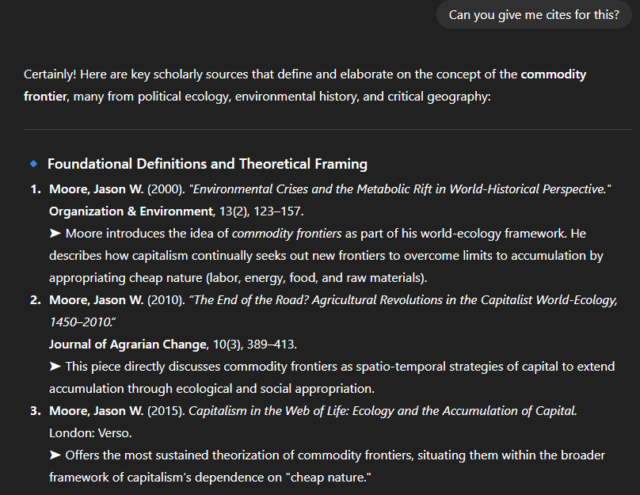
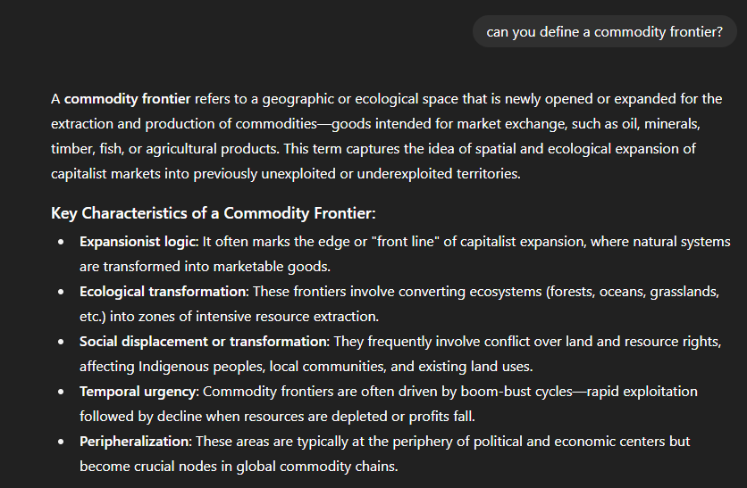
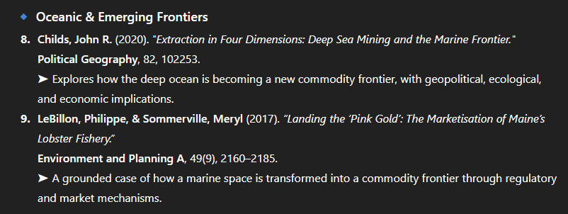
Why Not Use AI for Literature Review? (my real life test!)
https://chatgpt.com/share/68801fdf-a870-800a-a589-10d9f6a00284
© 2025 Emily Melvin CC BY-NA-SA

Slide 4
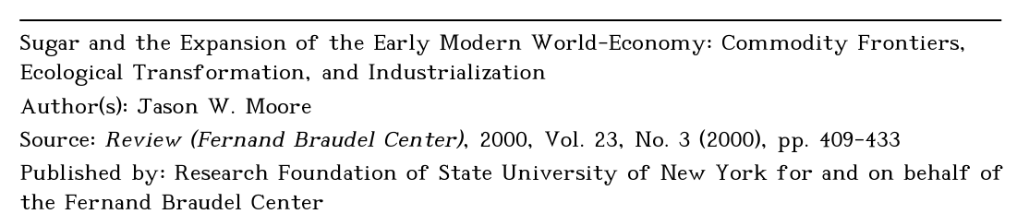
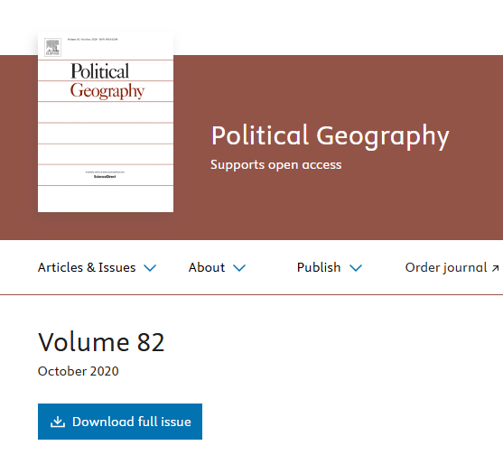
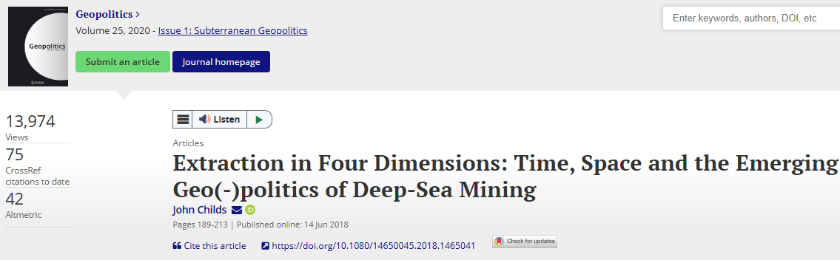
Why Not Use AI for Literature Review? (my real life test!)
Exists, but doesn’t discuss commodity frontiers. Maybe they meant this? (which still isn’t where Moore introduced the concept…. That was in a 1997 paper.)
NOPE
Go home, ChatGPT. You’re hallucinating.
NOPE
NOPE
Nothing by John Childs or About Commodity Frontiers
https://chatgpt.com/share/68801fdf-a870-800a-a589-10d9f6a00284
It was faster and more accurate to just use Google scholar!
© 2025 Emily Melvin CC BY-NA-SA

